Slide 1
Unscented Transform-Quadrature Point Transform
Nagavenkat Adurthi

Slide 2
From the basics….
Chapman Kolmogorov equation for state PDF propagation
Discretized CKE : results in a sum of weighted gaussian functions. We can calculate all the moments as they are just the weighted sum of the individual moments also.

Slide 3
Discretizing a General PDF
Solution approach is to pick points first(Approximate Grid Based method) or to pick the weights first and then find the sigma points.

Slide 4
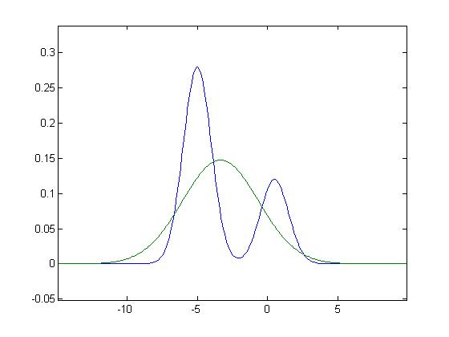
Ignoring the true PDF

Slide 5
Sigma points of a Gaussian PDF
Moments for normal PDF are simpler as every odd moment is zero. There for taking symmetric points about mean satisfy all odd moments.
A heuristic derivation

Slide 6
How accurate is the UT
Capturing the moments of the present PDF
Tracks the mean and covariance of the system only.
Compared to taylor series how well does it predict the moments of the PDF

Slide 7
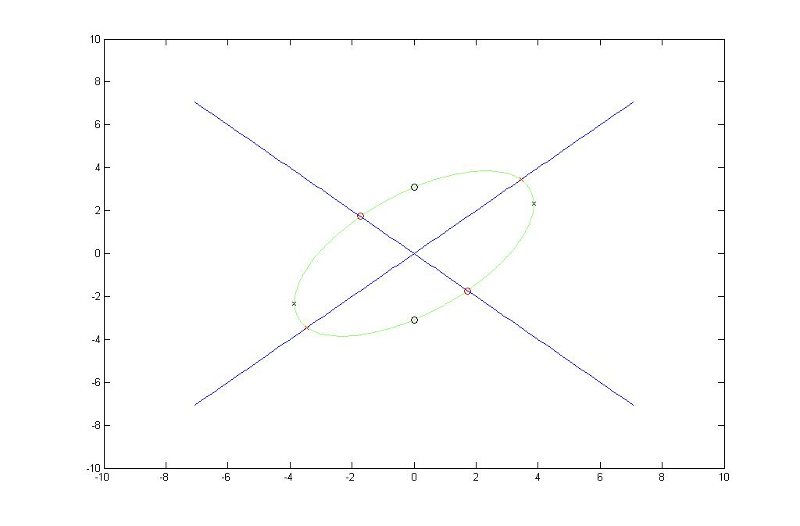
Multidimensional sigma points

Slide 8

Derivation of quadrature points till fourth moment accuracy
$$P=\left[\begin{matrix}P11 & P12 \\ P12 & P22\end{matrix}\right]$$
$$\sqrt{P}=AA^{T}$$
$$A=\left[\begin{matrix}s11 & s12 \\ s12 & s22\end{matrix}\right]$$
$$P11={s11}^{2}+{s12}^{2}$$
$$P12=s12 s11+s12 s22$$
$$P22={s22}^{2}+{s12}^{2}$$

Slide 9
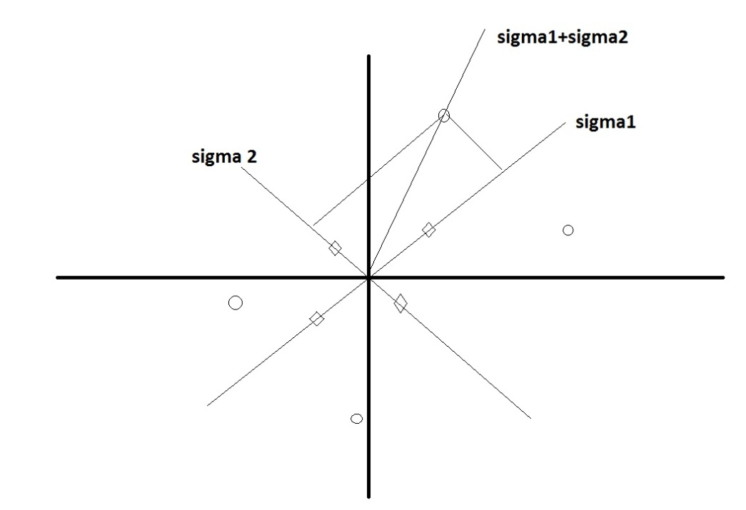




Pick directions on which to find points
$$σ_{1}=\left[\begin{matrix}s11 \\ s12\end{matrix}\right]$$
$$σ_{2}=\left[\begin{matrix}s12 \\ s22\end{matrix}\right]$$
$σ_{1}$+$σ_{2}$
$$σ_{1}−σ_{2}$$

Slide 10
The points chosen

Slide 11
2nd Moment – Covariance Matrix

